Slide 1
Introduction to
Hypothesis Testing

Slide 2
Trying to find Statistical Significance
Sir Ronald Fisher – 1926
Criterion for accepting statistical conclusion
How much evidence is enough to abandon “how we always done it?”

Slide 3
Why Test?
Gather evidence
Test status quo
Conservatism – place upper probability in favor of novel theory

Slide 4
What is a Hypothesis?
A hypothesis is a claim
(assumption) about a
population parameter:
  population mean
  population proportion
Example: The mean monthly cell phone bill of this city is µ = $123
Example: The proportion of adults in this city with cell phones is π = .68

Slide 5
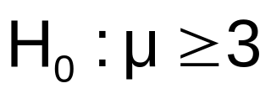

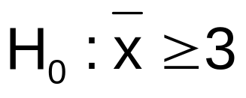
The Null Hypothesis, H₀
States the assumption (numerical) to be tested
  Example: The average number of TV sets in U.S. Homes is at least three ( )
Is always about a population parameter, not about a sample statistic

Slide 6
The Null Hypothesis, H₀
(continued)
Begin with the assumption that the null hypothesis is true
  Similar to the notion of innocent until
  proven guilty
Refers to the status quo
Always contains “=” , “≤” or “≥” sign
May or may not be rejected

Slide 7
The Alternative Hypothesis, H_{A}
Is the opposite of the null hypothesis
  e.g.: The average number of TV sets in U.S. homes is less than 3 ( H_{A}: µ < 3 )
Challenges the status quo
Never contains the “=” , “≤” or “≥” sign
May or may not be accepted
Is generally the hypothesis that is believed (or needs to be supported) by the researcher – a research hypothesis

Slide 8
Formulating Hypotheses
Example 1: Ford motor company has worked to reduce road noise inside the cab of the redesigned F150 pickup truck. It would like to report in its advertising that the truck is quieter. The average of the prior design was 68 decibels at 60 mph.
What is the appropriate hypothesis test?

Slide 9
Formulating Hypotheses
Example 1: Ford motor company has worked to reduce road noise inside the cab of the redesigned F150 pickup truck. It would like to report in its advertising that the truck is quieter. The average of the prior design was 68 decibels at 60 mph.
What is the appropriate test?
H₀: µ ≤ 68 (the truck is quieter) status quo
H_{A}: µ > 68 (the truck is not quieter)
If the null hypothesis is accepted, Ford has sufficient evidence to support that the truck is now quieter.

Slide 10
Formulating Hypotheses
Example 2: The average annual income of buyers of Ford F150 pickup trucks is claimed to be $85,000 per year. An industry analyst would like to test this claim.
What is the appropriate hypothesis test?

Slide 11
Formulating Hypotheses
Example 2: The average annual income of buyers of Ford F150 pickup trucks is claimed to be $65,000 per year. An industry analyst would like to test this claim.
What is the appropriate test?
H₀: µ = 85,000 (income is as claimed) status quo
H_{A}: µ ≠ 65,000 (income is different than claimed)
The analyst will believe the claim unless sufficient evidence is found to discredit it.

Slide 12
Hypothesis Testing Process
Claim: the population mean age is 50.
Null Hypothesis:
H₀: µ = 50
Population
Now select a random sample:
Sample
Is x = 20
likely if
µ = 50?
If not likely,
Suppose the sample mean age is 20:
x = 20
REJECT
Null Hypothesis

Slide 13
Reason for Rejecting H₀
Sampling Distribution of x
x
20
μ = 50
If H₀ is true
... then we reject the null hypothesis that μ = 50.
If it is unlikely that we would get a sample mean of this value ...
... if in fact this were
the population mean…

Slide 14
Errors in Making Decisions
Type I Error
  Reject a true null hypothesis
  Considered a serious type of error
  The probability of Type I Error is α
    Called level of significance of the test
    Set by researcher in advance

Slide 15
Type I Example
H_{o}: Patient is free of disease
H_{A}: Patient has disease
Run tests: receive false positive

Slide 16
Errors in Making Decisions
(continued)
Type II Error
  Fail to reject a false null hypothesis
  The probability of Type II Error is β
  β is a calculated value

Slide 17
Type II Example
H_{o}: Patient is free of disease
H_{A}: Patient has disease
Run tests: receive false negative

Slide 18
Outcomes and Probabilities
Possible Hypothesis Test Outcomes
State of Nature
Decision
H₀ True
H₀ False
Do Not
No error
(1 - )
Type II Error
( β )
Reject
Key:
Outcome
(Probability)
α
H
0
Reject
Type I Error
( )
No Error
( 1 - β )
H
α
0

Slide 19
Shown another way
Decision | Null hypothesis is True | Null hypothesis is False
Reject null hypothesis | Type I | Correct decision
Do Not Reject | Correct decision | Type II

Slide 20
Type I & II Error Relationship
Type I and Type II errors cannot happen at
the same time
  Type I error can only occur if H₀ is true
  Type II error can only occur if H₀ is false

Slide 21
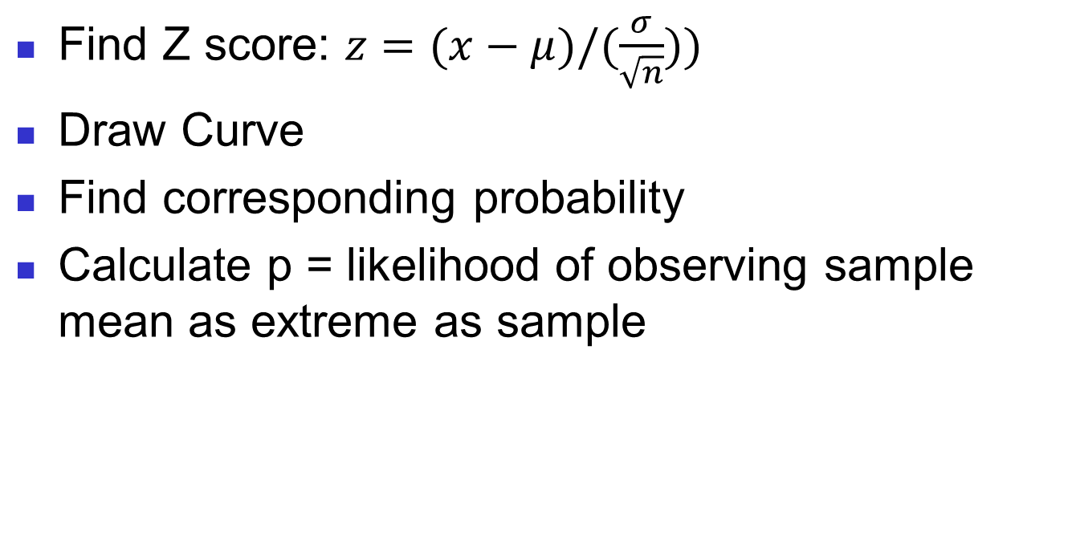
p-Value Approach

Slide 22
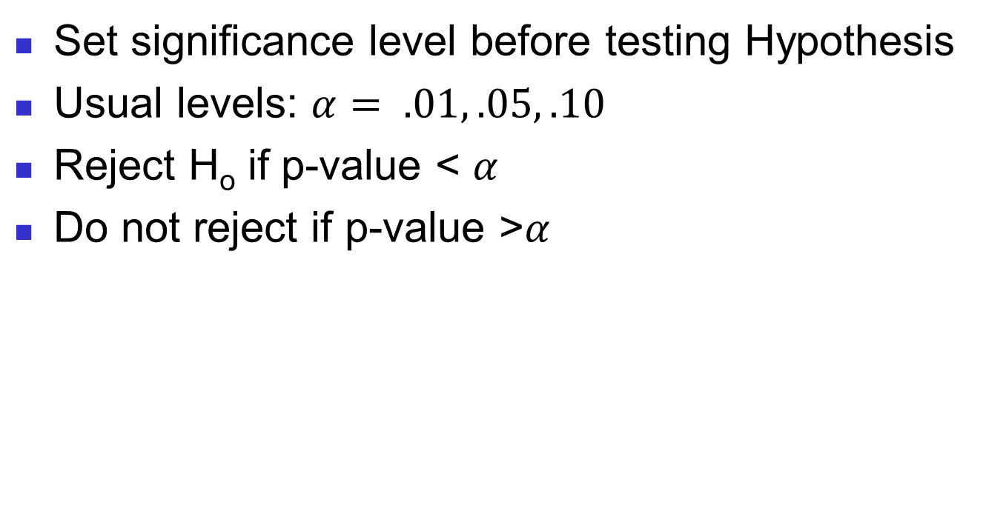
p-value approach to testing Hypothesis

Slide 23
Level of Significance, α
Defines unlikely values of sample statistic if null hypothesis is true
  Defines rejection region of the sampling distribution
Is designated by α , (level of significance)
  Typical values are .01, .05, or .10
Is selected by the researcher at the beginning
Provides the critical value(s) of the test

Slide 24
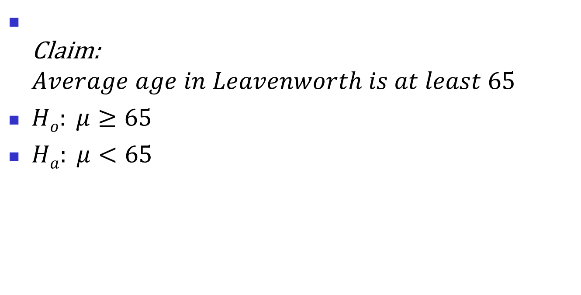
Example

Slide 25
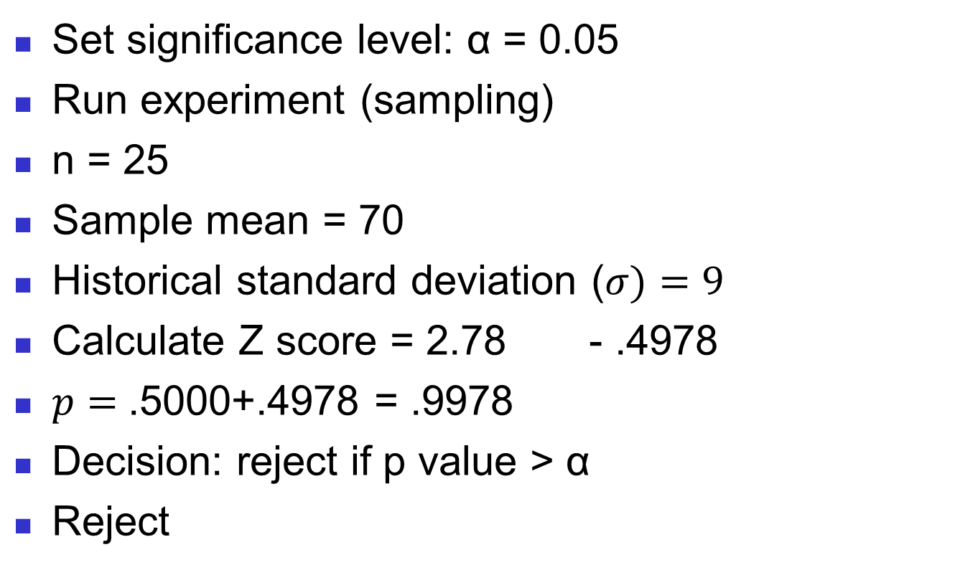
Example (cont)
<

Slide 26
Hypothesis Tests for the Mean
Hypothesis
Tests for μ
σ Known
σ Unknown
Assume first that the population standard deviation σ is known

Slide 27
Process of Hypothesis Testing
1. Specify population parameter of interest
2. Formulate the null and alternative hypotheses
3. Specify the desired significance level, α
4. Define the rejection region
5. Take a random sample and determine whether or not the sample result is in the rejection region
6. Reach a decision and draw a conclusion

Slide 28
Level of Significance and the Rejection Region
Level of significance =
α
Lower tail test
Upper tail test
Two tailed test
Example:
Example:
Example:
H₀: μ ≥ 3 H_{A}: μ < 3
H₀: μ ≤ 3 H_{A}: μ > 3
H₀: μ = 3 H_{A}: μ ≠ 3
α
α
α
α
/2
/2
-z_{α}
0
0
z_{α}
-z_{α/2}
0
z_{α/2}
Reject H₀
Do not reject H₀
Do not reject H₀
Reject H₀
Reject H₀
Do not reject H₀
Reject H₀

Slide 29
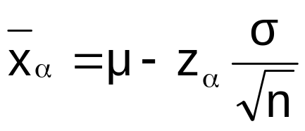
Critical Value for Lower Tail Test
H₀: μ ≥ 3
H_{A}: μ < 3
The cutoff value, or ,
is called a critical value
-z_{α}
x_{α}
α
Reject H₀
Do not reject H₀
-z_{α}
0
x_{α}
µ=3

Slide 30
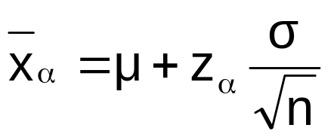
Critical Value for Upper Tail Test
The cutoff value, or ,
is called a critical value
H₀: μ ≤ 3
H_{A}: μ > 3
z_{α}
x_{α}
α
Do not reject H₀
Reject H₀
0
z_{α}
µ=3
x_{α}

Slide 31
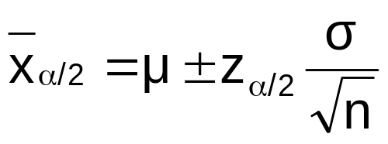
Critical Values for
Two Tailed Tests
There are two cutoff values (critical values):
or
H₀: μ = 3 H_{A}: μ ≠ 3
± z_{α/2}
α/2
α/2
x_{α/2}
Lower
Upper
x_{α/2}
Reject H₀
Do not reject H₀
Reject H₀
-z_{α/2}
0
z_{α/2}
x_{α/2}
µ=3
x_{α/2}
Lower
Upper

Slide 32



The Rejection Region
Lower tail test
Upper tail test
Two tailed test
Example:
Example:
Example:
H₀: μ ≥ 3 H_{A}: μ < 3
H₀: μ ≤ 3 H_{A}: μ > 3
H₀: μ = 3 H_{A}: μ ≠ 3
α
α
α
α
/2
/2
-z_{α}
0
0
z_{α}
-z_{α/2}
0
z_{α/2}
Reject H₀
Do not reject H₀
Do not reject H₀
Reject H₀
Reject H₀
Do not reject H₀
Reject H₀
Reject H₀ if z < -z_{α}
i.e., if x < x_{α}
Reject H₀ if z > z_{α}
i.e., if x > x_{α}
Reject H₀ if z < -z_{α/2} or z > z_{α/2}
i.e., if x < x_{α/2(L)} or x > x_{α/2(U)}

Slide 33
Approach
to Hypothesis Testing
z-units:
  For given α, find the critical z value(s):
    -z_{α} , z_{α} ,or ±z_{α/2}
  Convert the sample mean x to a z test statistic:
  Reject H₀ if z is in the rejection region,
  otherwise do not reject H₀

Slide 34
Hypothesis Testing Example
Test the claim that the true mean # of TV sets in US homes is at least 3.
(Assume σ = 0.8)
1. Specify the population value of interest
  The mean number of TVs in US homes
2. Formulate the appropriate null and alternative hypotheses
  H₀: μ ≥ 3 H_{A}: μ < 3 (This is a lower tail test)
3. Specify the desired level of significance
  Suppose that α = .05 is chosen for this test

Slide 35
Hypothesis Testing Example
(continued)
4. Determine the rejection region
α = .05
Reject H₀
Do not reject H₀
-z_{α}= -1.645
0
This is a one-tailed test with α = .05.
Since σ is known, the cutoff value is a z value:
Reject H₀ if z < z_{α} = -1.645 ; otherwise do not reject H₀

Slide 36
Hypothesis Testing Example
5. Obtain sample evidence and compute the test statistic
Suppose a sample is taken with the following results: n = 100, x = 2.84 (σ = 0.8 is assumed known)
  Then the test statistic is:

Slide 37
Hypothesis Testing Example
(continued)
6. Reach a decision and interpret the result
α = .05
z
Reject H₀
Do not reject H₀
-1.645
0
-2.0
Since z = -2.0 < -1.645, we reject the null hypothesis that the mean number of TVs in US homes is at least 3. There is sufficient evidence that the mean is less than 3.

Slide 38

Example: Upper Tail z Test for Mean (σ Known)
A phone industry manager thinks that customer monthly cell phone bill have increased, and now average over $52 per month. The company wishes to test this claim. (Assume σ = 10 is known)
Form hypothesis test:
H₀: μ ≤ 52 the average is not over $52 per month
H_{A}: μ > 52 the average is greater than $52 per month
(i.e., sufficient evidence exists to support the
manager’s claim)

Slide 39
Testing Hypotheses

Slide 40
The Test Statistic and
Critical Values
If the sample mean is close to the stated population mean, the null hypothesis is not rejected.
If the sample mean is far from the stated population mean, the null hypothesis is rejected.
How far is “far enough” to reject H₀?
The critical value of a test statistic creates a “line in the sand” for decision making -- it answers the question of how far is far enough.

Slide 41
The Test Statistic and
Critical Values
If the sample mean is close to the stated population mean, the null hypothesis is not rejected.
If the sample mean is far from the stated population mean, the null hypothesis is rejected.
How far is “far enough” to reject H₀?
The critical value of a test statistic creates a “line in the sand” for decision making -- it answers the question of how far is far enough.

Slide 42
Possible Errors in Hypothesis Test Decision Making
(continued)
The confidence coefficient (1-α) is the probability of not rejecting H₀ when it is true.
The confidence level of a hypothesis test is (1-α)*100%.
The power of a statistical test (1-β) is the probability of rejecting H₀ when it is false.

Slide 43
Type I & II Error Relationship
Type I and Type II errors cannot happen at
the same time
  A Type I error can only occur if H₀ is true
  A Type II error can only occur if H₀ is false
If Type I error probability (α) , then
Type II error probability (β)

Slide 44
6 Steps in
Hypothesis Testing
State the null hypothesis, H₀ and the alternative hypothesis, H_{A}
Choose the level of significance, α, and the sample size, n
Determine the appropriate test statistic and sampling distribution
Determine the critical values that divide the rejection and nonrejection regions

Slide 45
6 Steps in
Hypothesis Testing
(continued)
Collect data and compute the value of the test statistic
Make the statistical decision and state the managerial conclusion. If the test statistic falls into the nonrejection region, do not reject the null hypothesis H₀. If the test statistic falls into the rejection region, reject the null hypothesis. Express the managerial conclusion in the context of the problem

Slide 46
Hypothesis Testing Example
Test the claim that the true mean diameter of a manufactured bolt is 30mm.
(Assume σ = 0.8)
1. State the appropriate null and alternative
hypotheses
  H₀: μ = 30 H₁: μ ≠ 30 (This is a two-tail test)
2. Specify the desired level of significance and the sample size
  Suppose that α = 0.05 and n = 100 are chosen for this test

Slide 47
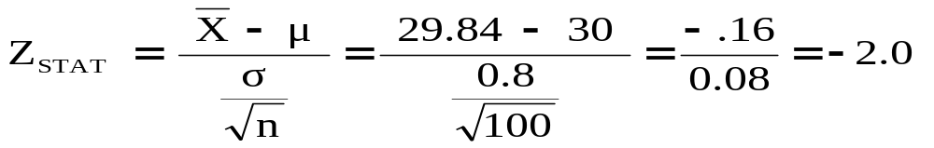
Hypothesis Testing Example
(continued)
3. Determine the appropriate technique
  σ is assumed known so this is a Z test.
4. Determine the critical values
  For α = 0.05 the critical Z values are ±1.96
5. Collect the data and compute the test statistic
  Suppose the sample results are
  n = 100, X = 29.84 (σ = 0.8 is assumed known)
  So the test statistic is:

Slide 48
Hypothesis Testing Example
(continued)
6. Is the test statistic in the rejection region?
α/2 = 0.025
α/2 = 0.025
Reject H₀ if Z_{STAT} < -1.96 or Z_{STAT} > 1.96; otherwise do not reject H₀
Reject H₀
Do not reject H₀
Reject H₀
-Z_{α/2} = -1.96
0
+Z_{α/2} = +1.96
Here, Z_{STAT} = -2.0 < -1.96, so the test statistic is in the rejection region

Slide 49
Hypothesis Testing Example
(continued)
6 (continued). Reach a decision and interpret the result
α = 0.05/2
α = 0.05/2
Reject H₀
Do not reject H₀
Reject H₀
-Z_{α/2} = -1.96
0
+Z_{α/2}= +1.96
-2.0
Since Z_{STAT} = -2.0 < -1.96, reject the null hypothesis and conclude there is sufficient evidence that the mean diameter of a manufactured bolt is not equal to 30

Slide 50
p-value Hypothesis Testing Example
Test the claim that the true mean diameter of a manufactured bolt is 30mm.
(Assume σ = 0.8)
1. State the appropriate null and alternative
hypotheses
  H₀: μ = 30 H₁: μ ≠ 30 (This is a two-tail test)
2. Specify the desired level of significance and the sample size
  Suppose that α = 0.05 and n = 100 are chosen for this test

Slide 51
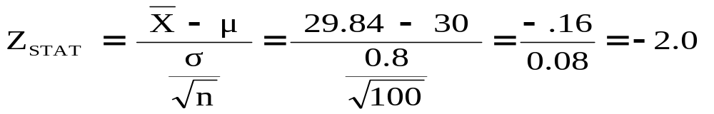
p-value Hypothesis Testing Example
(continued)
3. Determine the appropriate technique
  σ is assumed known so this is a Z test.
4. Collect the data, compute the test statistic and the p-value
  Suppose the sample results are
  n = 100, X = 29.84 (σ = 0.8 is assumed known)
  So the test statistic is:

Slide 52
p-Value Hypothesis Testing Example:
Calculating the p-value
4. (continued) Calculate the p-value.
  How likely is it to get a Z_{STAT} of -2 (or something farther from the mean (0), in either direction) if H₀ is true?
P(Z < -2.0) = 0.0228
P(Z > 2.0) = 0.0228
0
Z
-2.0
2.0
p-value = 0.0228 + 0.0228 = 0.0456
Z = 2.0 = probability of .4772

Slide 53
p-value Hypothesis Testing Example
(continued)
5. Is the p-value < α?
  Since p-value = 0.0456 < α = 0.05 Reject H₀
  State the managerial conclusion in the context of the situation.
  There is sufficient evidence to conclude the average diameter of a manufactured bolt is not equal to 30mm.

Slide 54
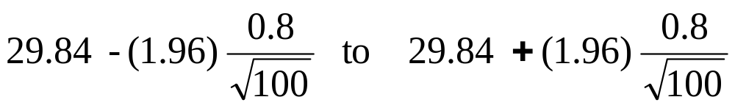
Connection Between Two-Tail Tests and Confidence Intervals
For X = 29.84, σ = 0.8 and n = 100, the 95% confidence interval is:
Since this interval does not contain the hypothesized mean (30), we reject the null hypothesis at α = 0.05
29.6832 ≤ μ ≤ 29.9968

Slide 55
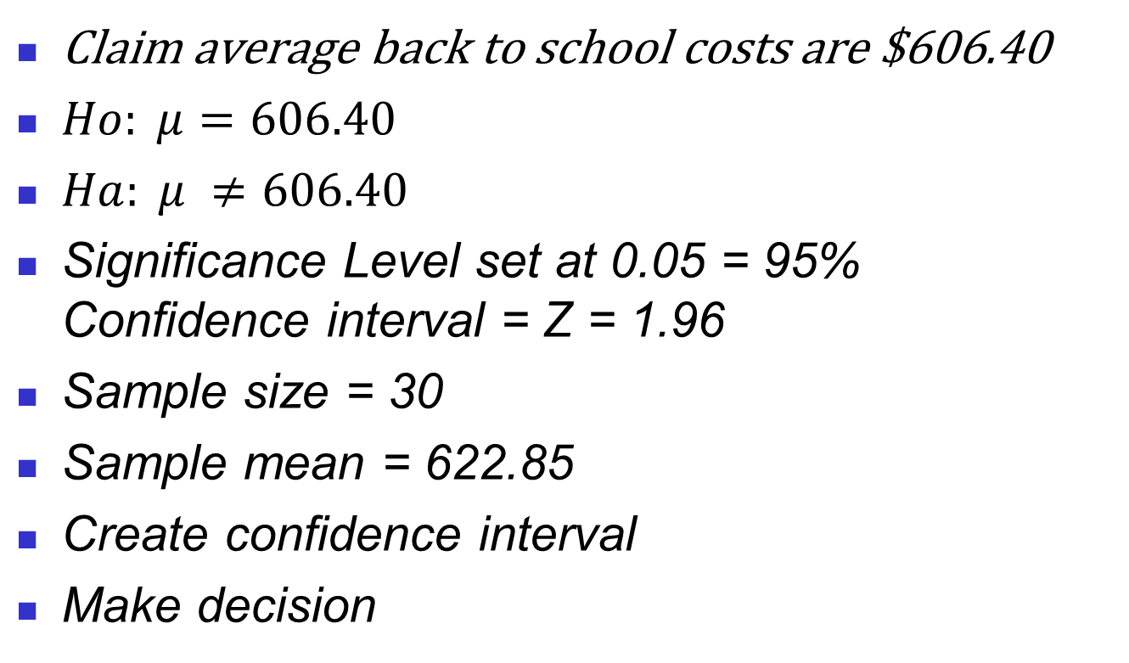
Example Testing with Confidence Intervals

Slide 56
Do You Ever Truly Know σ?
Probably not!
In virtually all real world business situations, σ is not known.
If there is a situation where σ is known then µ is also known (since to calculate σ you need to know µ.)
If you truly know µ there would be no need to gather a sample to estimate it.

Slide 57
Example: Two-Tail Test
(σ Unknown)
The average cost of a hotel room in New York is said to be $168 per night. To determine if this is true, a random sample of 25 hotels is taken and resulted in an X of $172.50 and an S of $15.40. Test the appropriate hypotheses at α = 0.05.
(Assume the population distribution is normal)
H₀: ______
H_{A}: ______

Slide 58
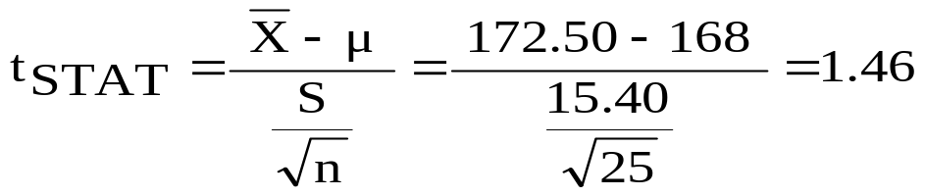
Example Solution:
Two-Tail t Test
H₀: μ = 168
H_{A}: μ ≠ 168
α/2=.025
α/2=.025
α = 0.05
n = 25, df = 25-1=24
σ is unknown, so
use a t statistic
Critical Value:
±t_{24,0.025} = ± 2.0639
Reject H₀
Do not reject H₀
Reject H₀
-t _{24,0.025}
t _{24,0.025}
0
-2.0639
2.0639
1.46
Do not reject H₀: insufficient evidence that true mean cost is different from $168

Slide 59
Introduction to Linear Regression and Correlation Analysis
Business Statistics:
A Decision-Making Approach

Slide 60
Scatter Plots and Correlation
A scatter plot (or scatter diagram) is used to show the relationship between two variables
Correlation analysis is used to measure strength of the association (linear relationship) between two variables
  Only concerned with strength of the relationship
  No causal effect is implied

Slide 61
Scatter Plot Examples
Linear relationships
Curvilinear relationships
y
y
x
x
y
y
x
x

Slide 62
Scatter Plot Examples
(continued)
Strong relationships
Weak relationships
y
y
x
x
y
y
x
x

Slide 63
Scatter Plot Examples
(continued)
No relationship
y
x
y
x

Slide 64
Correlation Coefficient
(continued)
Correlation measures the strength of the linear association between two variables
The sample correlation coefficient r is a measure of the strength of the linear relationship between two variables, based on sample observations

Slide 65
Features of r
Unit free
Range between -1 and 1
The closer to -1, the stronger the negative linear relationship
The closer to 1, the stronger the positive linear relationship
The closer to 0, the weaker the linear relationship

Slide 66
Examples of Approximate r Values
y
y
y
x
x
x
r = -1
r = -.6
r = 0
y
y
x
x
r = +.3
r = +1

Slide 67
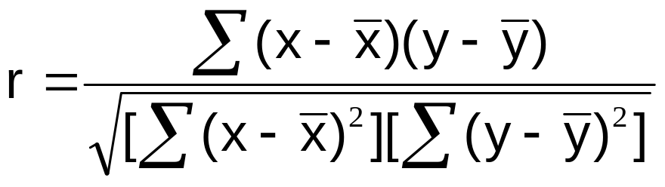
Calculating the
Correlation Coefficient
Sample correlation coefficient:
where:
r = Sample correlation coefficient
n = Sample size
x = Value of the independent variable
y = Value of the dependent variable

Slide 68
Calculation Example
Tree Height | Trunk Diameter
y | x | xy | y² | x²
35 | 8 | 280 | 1225 | 64
49 | 9 | 441 | 2401 | 81
27 | 7 | 189 | 729 | 49
33 | 6 | 198 | 1089 | 36
60 | 13 | 780 | 3600 | 169
21 | 7 | 147 | 441 | 49
45 | 11 | 495 | 2025 | 121
51 | 12 | 612 | 2601 | 144
Σ=321 | Σ=73 | Σ=3142 | Σ=14111 | Σ=713

Slide 69
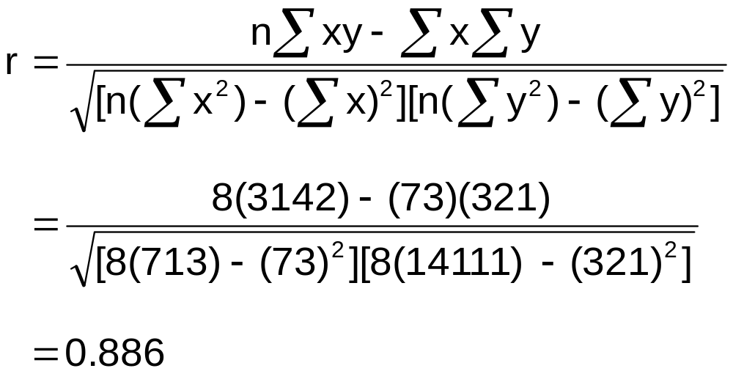
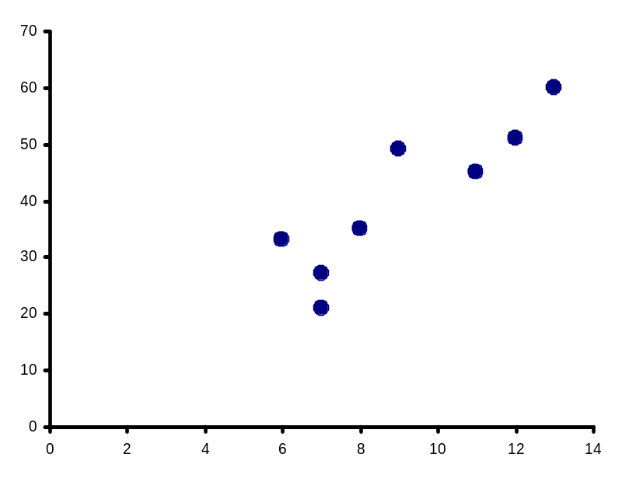
Calculation Example
(continued)
Tree Height,
y
r = 0.886 → relatively strong positive
linear association between x and y
Trunk Diameter, x

Slide 70
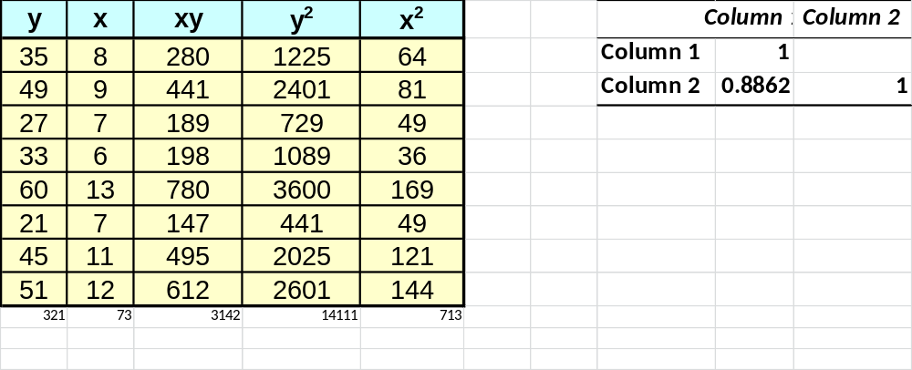
Excel Output

Slide 71
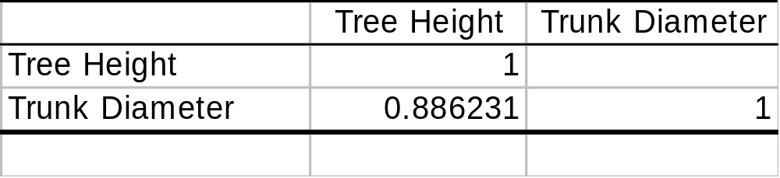
Excel Output
Excel Correlation Output
Tools / data analysis / correlation…
Correlation between
Tree Height and Trunk Diameter

Slide 72
Introduction to
Regression Analysis
Regression analysis is used to:
  Predict the value of a dependent variable based on the value of at least one independent variable
  Explain the impact of changes in an independent variable on the dependent variable
Dependent variable: the variable we wish to explain
Independent variable: the variable used to explain the dependent variable

Slide 73
Simple Linear Regression Model
Only one independent variable, x
Relationship between x and y is described by a linear function
Changes in y are assumed to be caused by changes in x

Slide 74
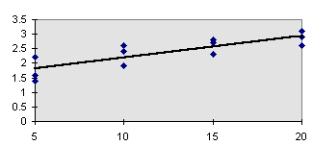
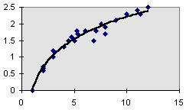
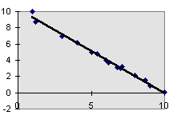
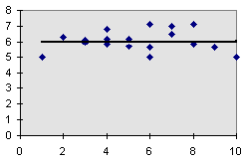
Types of Regression Models
Positive Linear Relationship
Relationship NOT Linear
Negative Linear Relationship
No Relationship

Slide 75
Simple Linear Regression Example
A real estate agent wishes to examine the relationship between the selling price of a home and its size (measured in square feet)
A random sample of 10 houses is selected
  Dependent variable (y) = house price in $1000s
  Independent variable (x) = square feet

Slide 76
Sample Data for
House Price Model
House Price in $1000s (y) | Square Feet (x)
245 | 1400
312 | 1600
279 | 1700
308 | 1875
199 | 1100
219 | 1550
405 | 2350
324 | 2450
319 | 1425
255 | 1700

Slide 77
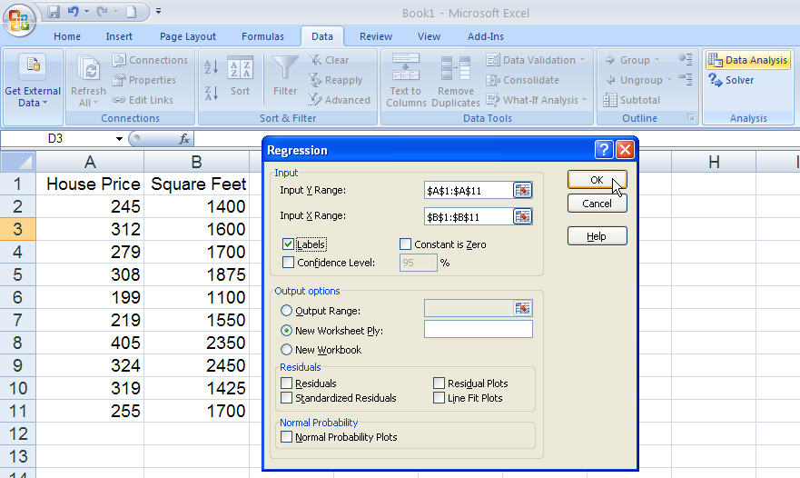
Regression Using Excel
Data / Data Analysis / Regression

Slide 78
Excel Output
Regression Statistics
Multiple R | 0.76211
R Square | 0.58082
Adjusted R Square | 0.52842
Standard Error | 41.33032
Observations | 10
ANOVA | df | SS | MS | F | Significance F
Regression | 1 | 18934.9348 | 18934.9348 | 11.0848 | 0.01039
Residual | 8 | 13665.5652 | 1708.1957
Total | 9 | 32600.5000
 | Coefficients | Standard Error | t Stat | P-value | Lower 95% | Upper 95%
Intercept | 98.24833 | 58.03348 | 1.69296 | 0.12892 | -35.57720 | 232.07386
Square Feet | 0.10977 | 0.03297 | 3.32938 | 0.01039 | 0.03374 | 0.18580
The regression equation is:

Slide 79
In class exercise
X value – miles driven | Y value – defects in engines
300 | 4
475 | 6
750 | 9
650 | 7
1000 | 12
900 | 10
450 | 5
400 | 3
250 | 1

Slide 80
Chapter Summary
Introduced correlation analysis
Discussed correlation to measure the strength of a linear association
Introduced simple linear regression analysis

